Slide 1
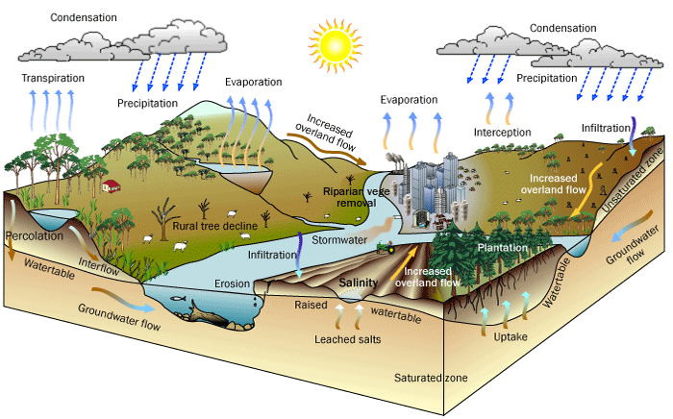


Environmental flows in IWRM
Mike Acreman

Slide 2
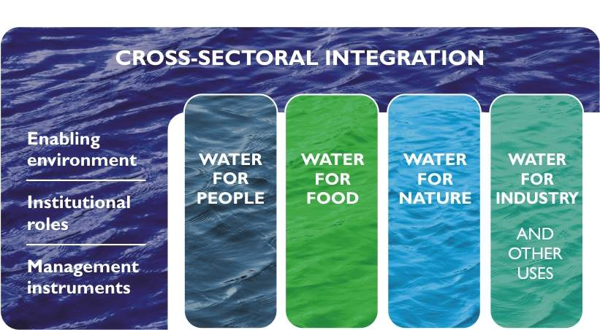

IWRM goals
Economically efficient water use
Assessments of supplies, sound allocation, efficient technologies
Equitable access
Appropriate institutions, users’ associations, stakeholder sharing
Environmental sustainability
water quality standards
flow standards

Slide 3
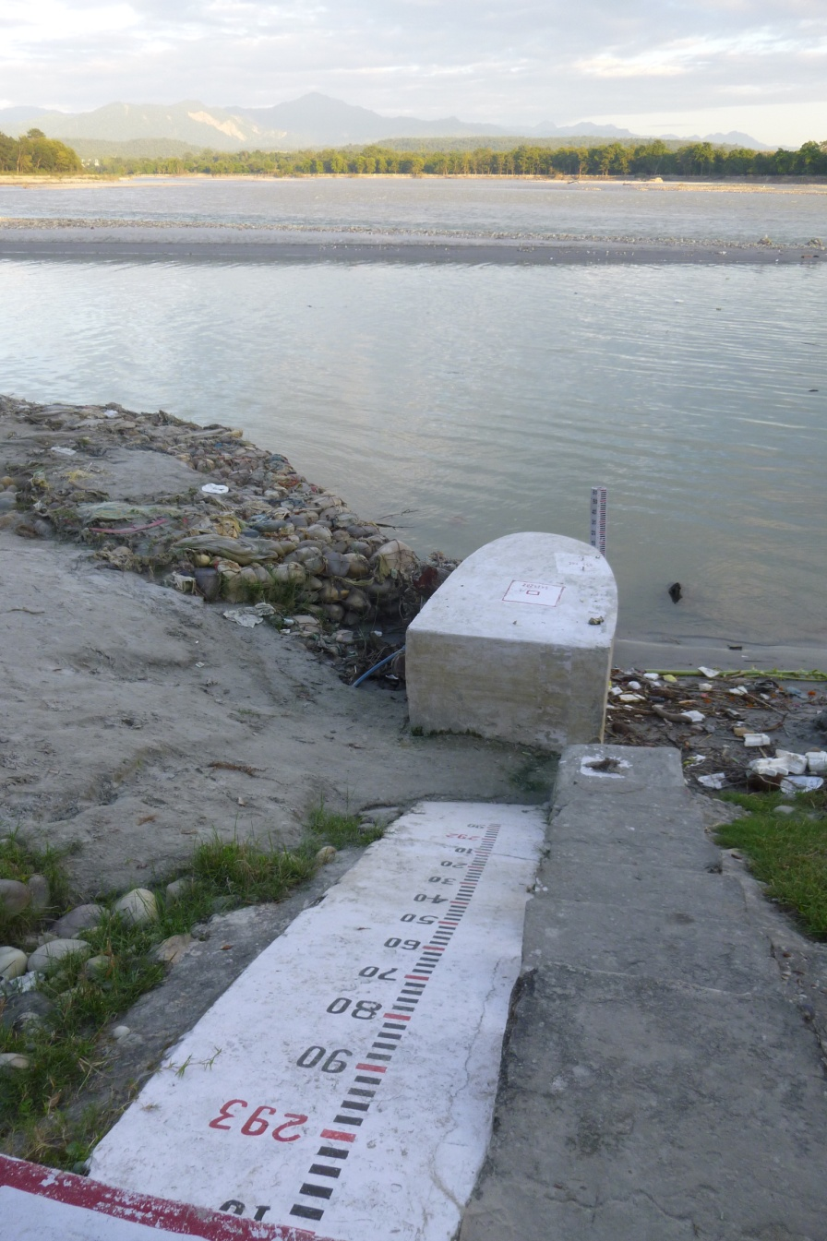
Draft River Basin Management Act
Environmental flows
River Basin Master Plans accounting for needs of aquatic ecosystems

Slide 4
Managing water allocation
water resource
over allocation
}
}
Environmental provision
Public supply
Hydro-power
Industry
Irrigation

Slide 5
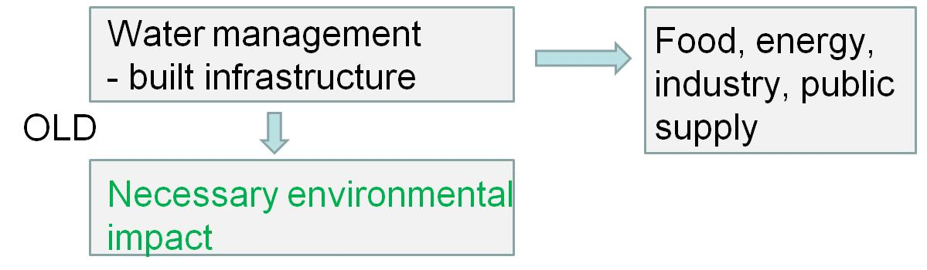
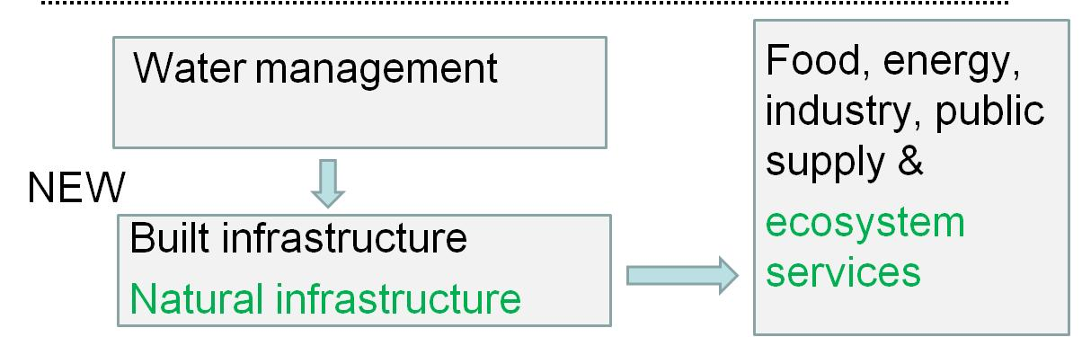
Paradigm change (after WWAP)
EIA
EOA

Slide 6
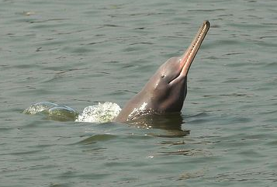
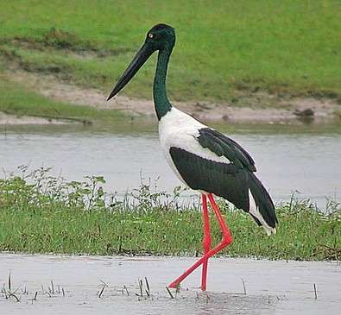
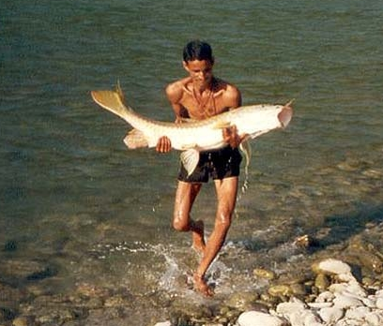
Biodiversity
Nature conservation
Biodiversity (e.g. river dolphins)

Slide 7
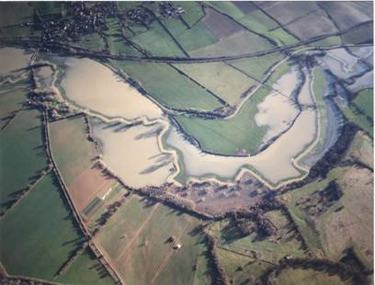
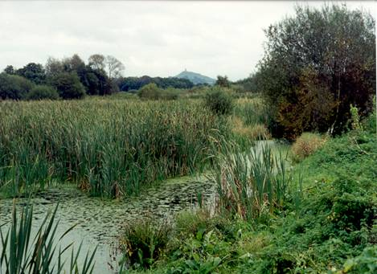
Water services
Wetlands & floodplains
to regulate flows and purify water
human health

Slide 8
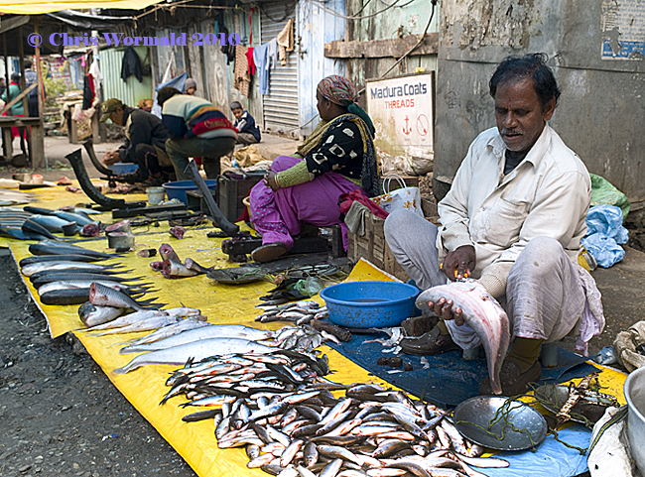
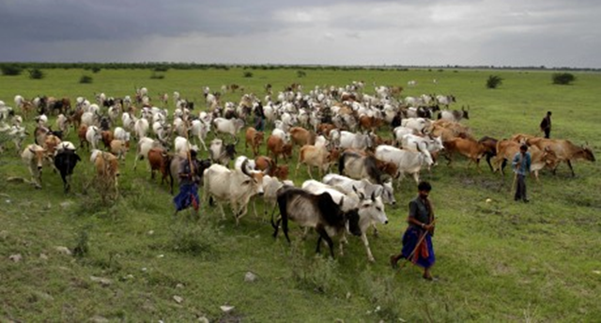
Local livelihoods
Fish for fisheries
Grass for cattle
Fertile soils and natural irrigation

Slide 9
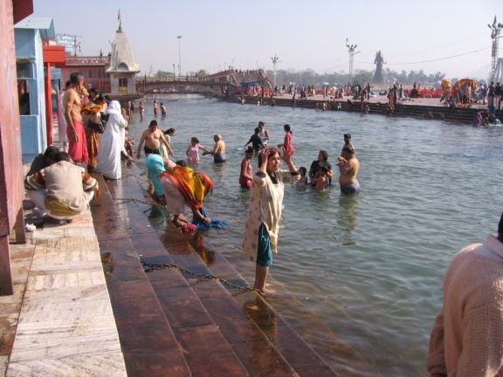
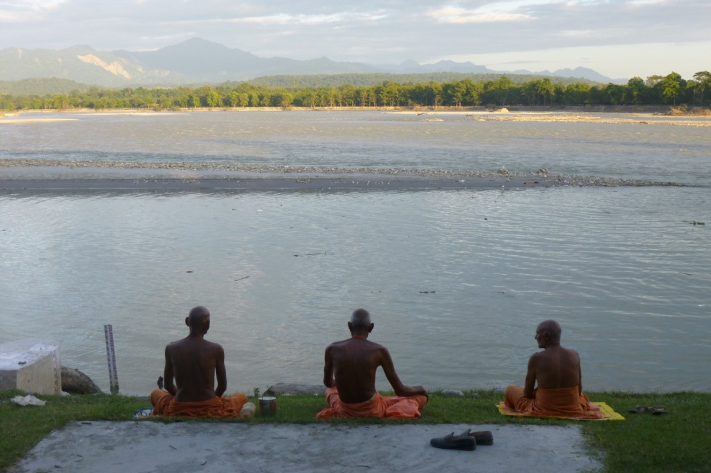
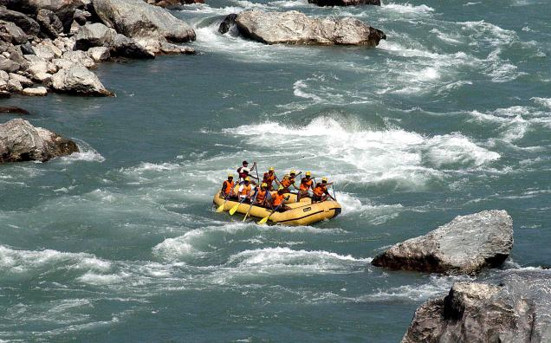
Cultural services
Family/community history
Spiritual/religious connection
Tourism
Quality of life

Slide 10
Brisbane Declaration 2007
Managing water at the basin scale
Environmental flows describe the quantity, timing and quality of water flows required to sustain freshwater and estuarine ecosystems and the human livelihoods and well-being that depend on these ecosystems.

Slide 11
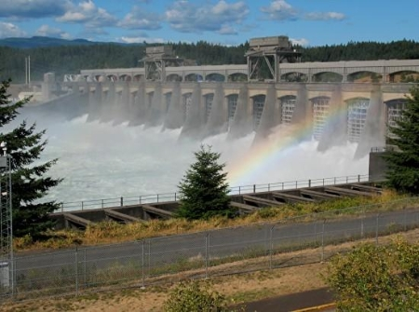
How much water does a river need?
No single answer
Over 250 methods
Big questions
What sort of river do you want?
What are the pressures on the river?
What will the future bring?

Slide 12
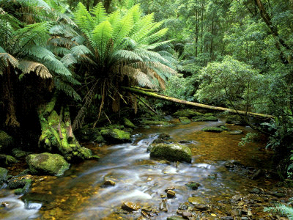
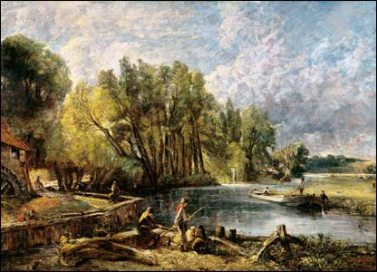
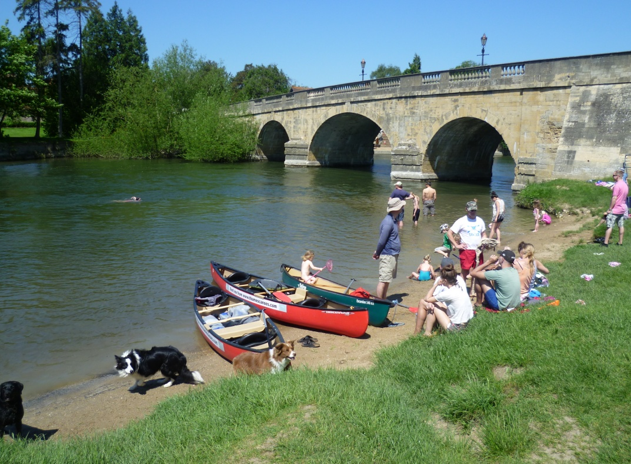
What sort of river do you want?
natural
10,000 BC
golden age
1821
when I was young

Slide 13
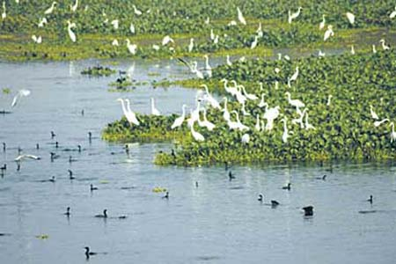
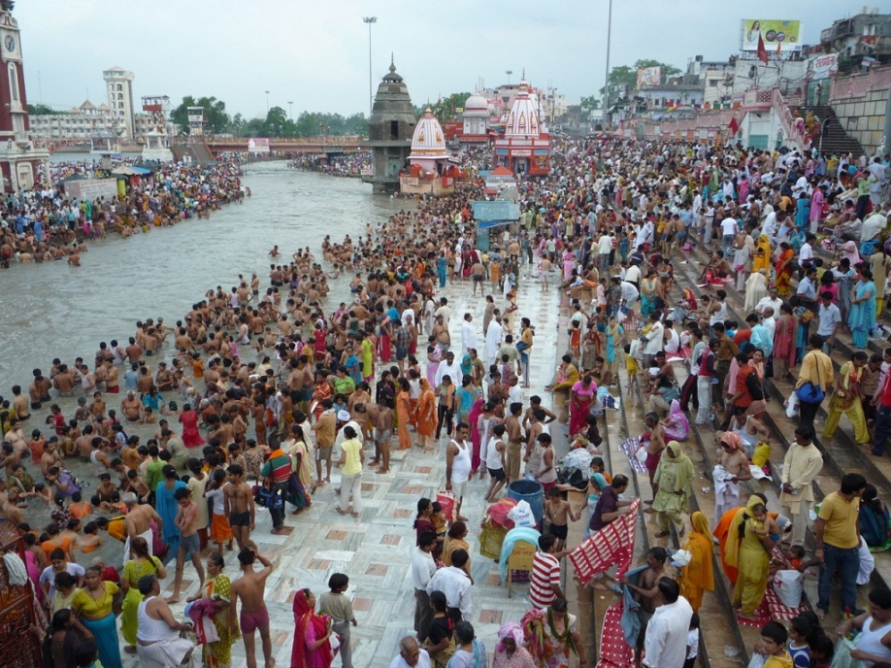
Objective-based flows
Conservation objective
maintain nature character e.g. Ramsar site
Ecosystem service objective
Maintain depth for river festival

Slide 14
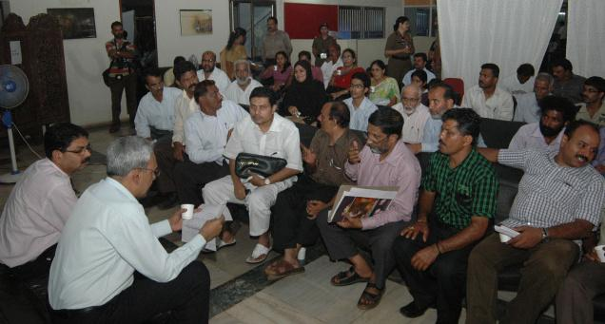
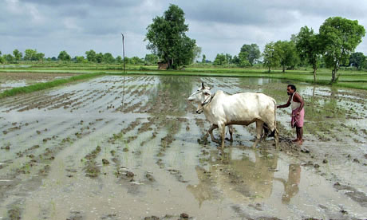
Scenario-based flow setting
No pre-set objective
Stakeholder participation
– awareness raising
local community action
Trade-off between water uses
– economic value
political decision
£

Slide 15
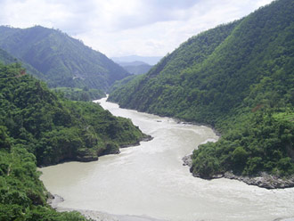
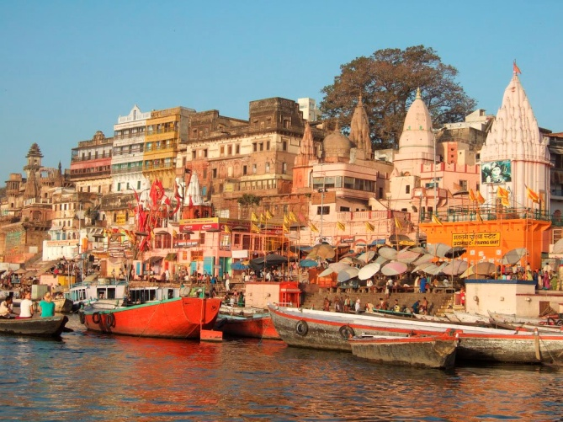
River management classes
Class 1 natural
Class 2 semi-natural
Class 3 working river

Slide 16

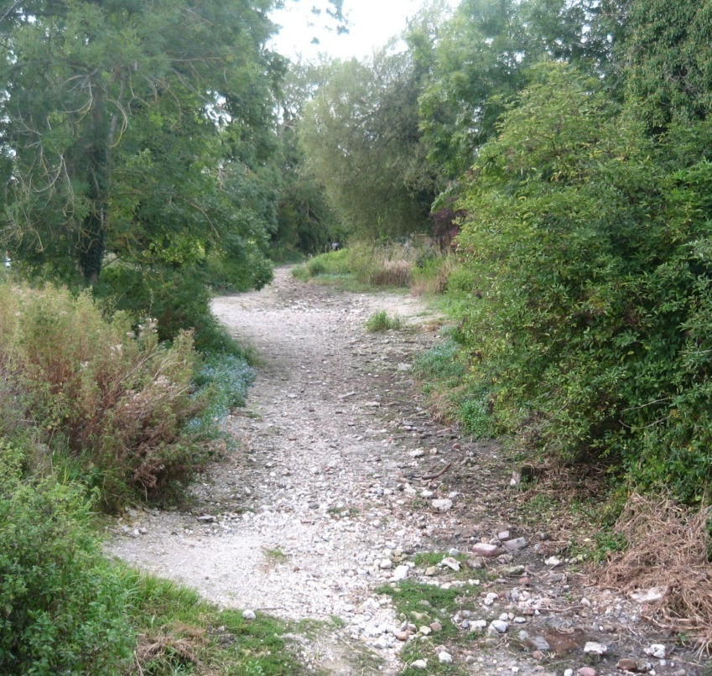
2012 Blueprint to Safeguard Europe's Water Resources
What are the pressures on the river?
Pressure on river ecosystems
No 1 pressure = dams, land drainage; flood embankments
No 2 pressure = over-abstraction of water → identification of “ecological or environmental flow”

Slide 17
Why is flow important?
channel maintenance flood
floodplain connectivity
maintenance flows for spawning and dispersal
freshet trigger flows for migration
low flows for juveniles
not enough
J F M A M J J A S O N D
All aspects of the flow regime are important for some element of the river ecosystem

Slide 18
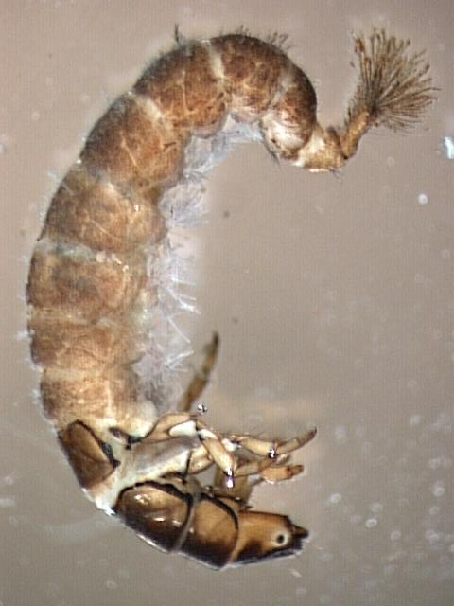
Can we quantify the importance of flow for river health?
2001
LIFE score
1991
2009
1997
Flow index
No threshold

Slide 19
River sensitivity
sensitive rivers
low abstraction
Ecosystem score
Ecosystem score
Ecosystem score
flow
flow
flow
robust rivers
high abstraction
Ecosystem score
Ecosystem score
Ecosystem score
flow
flow
flow

Slide 20
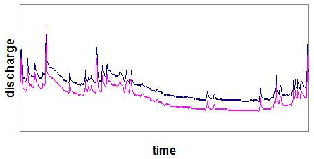
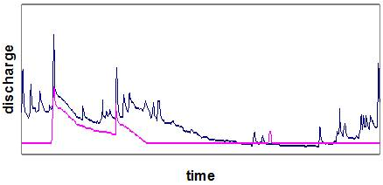
How do pressures alter river flow?
Direct abstractions
Reduced baseline – maintain variability
Restrictive management
Dams/impoundments
Magnitude and variability may be reduced; magnitude may be increased
Active management

Slide 21
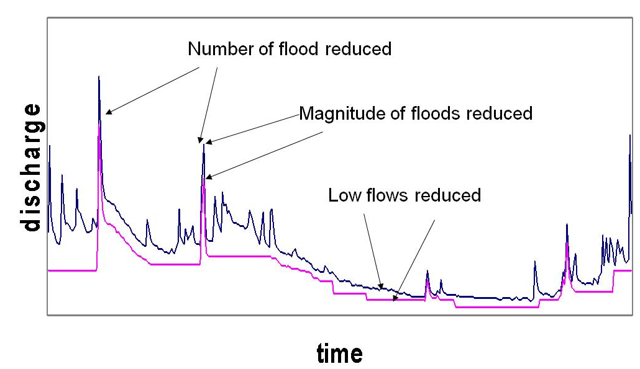
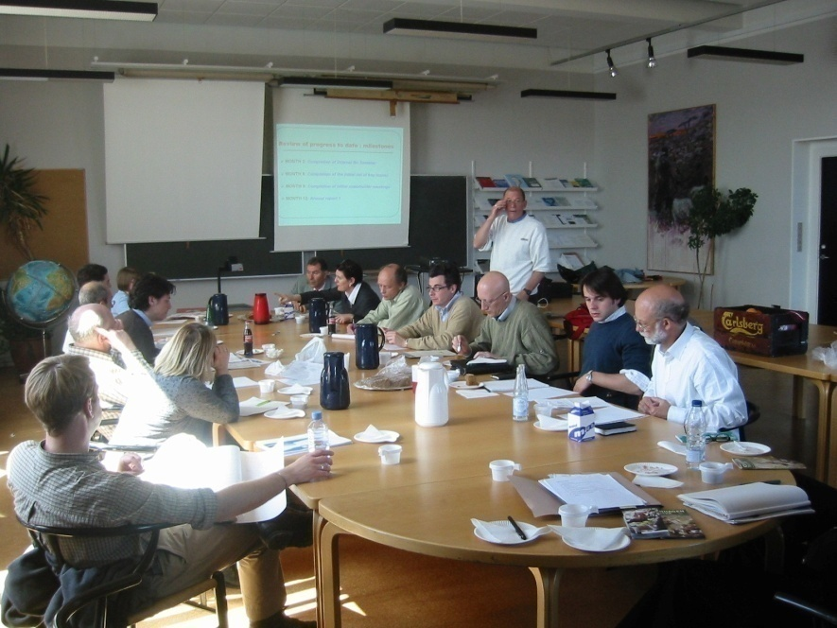
Abstraction management
How much can we alter the flow regime ...?
... but maintain desired ecological condition?
Standards often developed by expert panels – i.e. synthesis of knowledge and experience

Slide 22
Maximum abstractions % of natural flow
High flow
Medium
flow
Low flow
Drought
Lowland meandering
Middle reaches
Headwaters

Slide 23
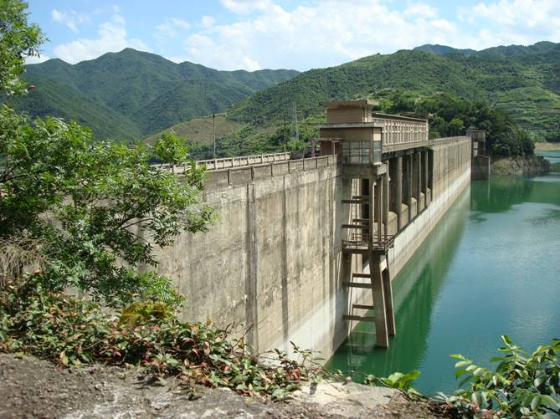
Impoundment releases
Heavily Modified Water Body
Target = Good Ecological Potential
Best practice
Stakeholder objectives
Dams have major control over flow regime
Release flows to meet desired ecosystem services

Slide 24
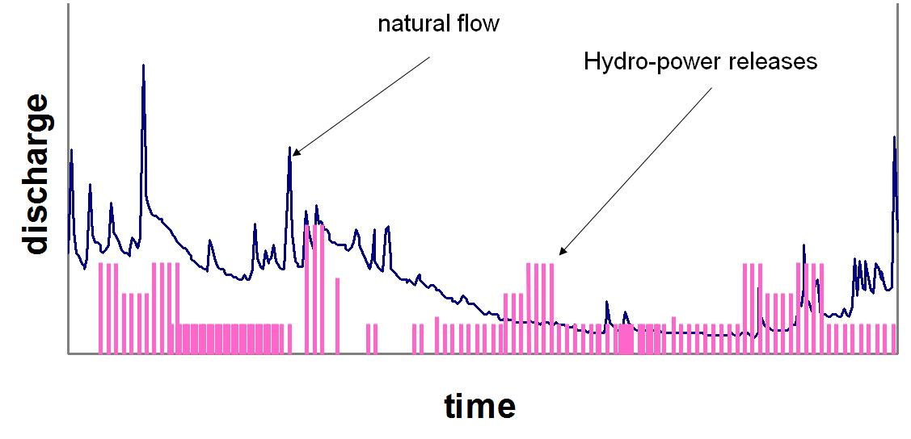
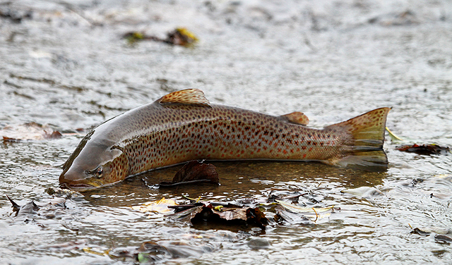
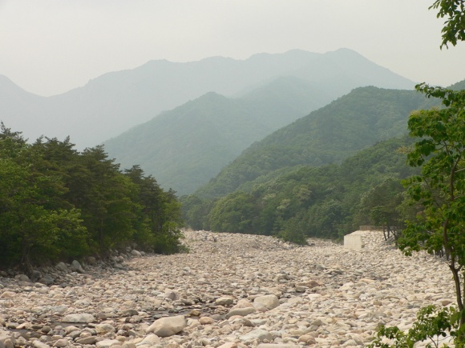
Hydro-power issues
Hydro peaking
‘ramping’
Impacted reach
power house
off take
river
return
impacted reach

Slide 25
E-flow releases from dams
channel maintenance flood
floodplain connectivity
maintenance flows for spawning and dispersal
freshet trigger flows for migration
low flows for juveniles
Quantity – magnitude, timing, duration, frequency
Quality – temperature, sediment

Slide 26
E-flow release regime
environmental flow
natural flow

Slide 27
Implementation
Need strong political will to address over-allocated rivers
Identify champions
Assess supply-side and demand-side options
Provide incentives for efficiency
Define operational rules
Set-up monitoring

Slide 28
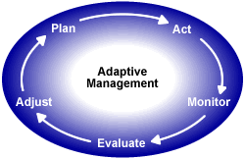
Adaptive management
E-flow assessments uncertain
Responses un-predicable
Circumstances change
Need to act, monitor, evaluate and adjust
Not admission of error

Slide 29
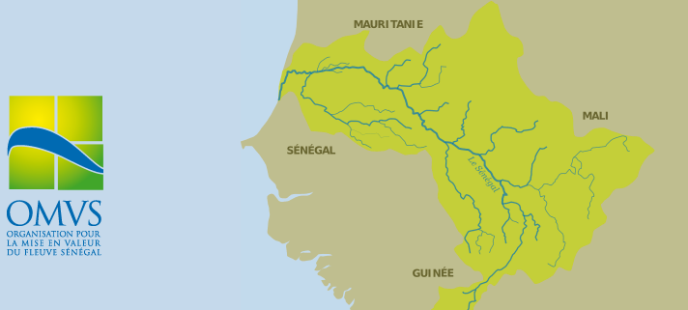
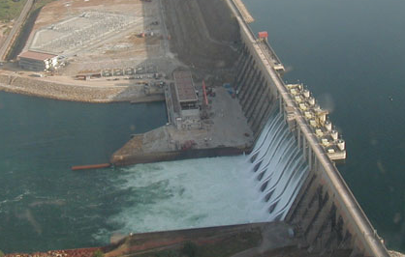
Inter-sectoral coordination
Senegal River Basin Development Authority
Senegal, Mali, Mauritania
Managing Manatali dam
Balancing hydropower, navigation, eflows for floodplain agriculture

Slide 30
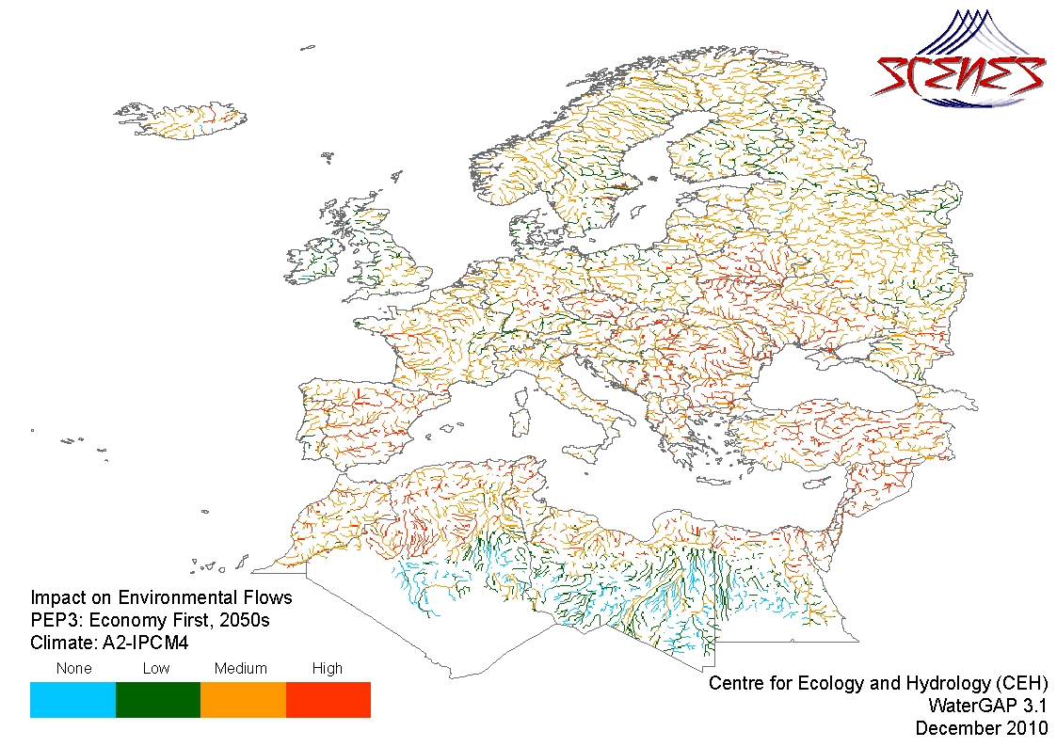
Risk of future ecological impact from hydrological alteration

Slide 31
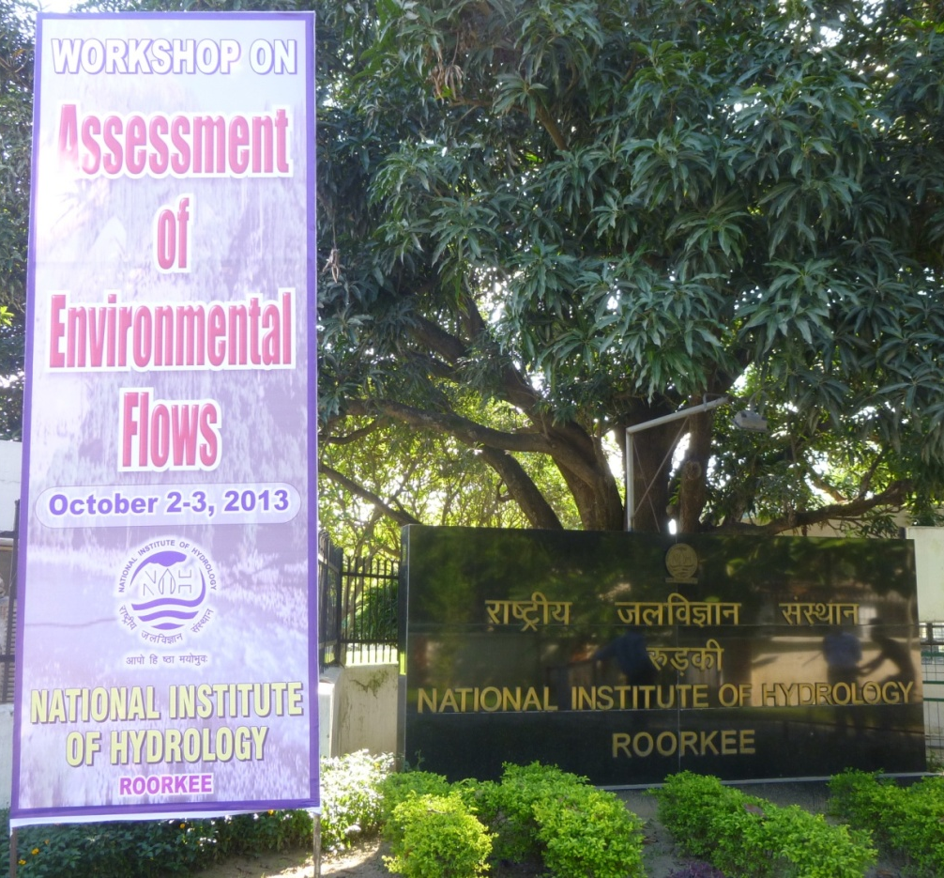
Environmental flow workshop NIH Roorkee October 2013
35 river system experts
academia
government researcher
NGOs
power industry
Central Water Commission
World Bank.

Slide 32
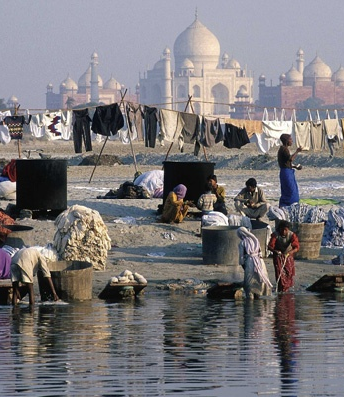
Workshop conclusions
India has world leading water managers
Strong history in irrigation, hydraulic engineering
Environmental flows emerging issue worldwide
India need skills in environmental flows to stay at cutting-edge

Slide 33
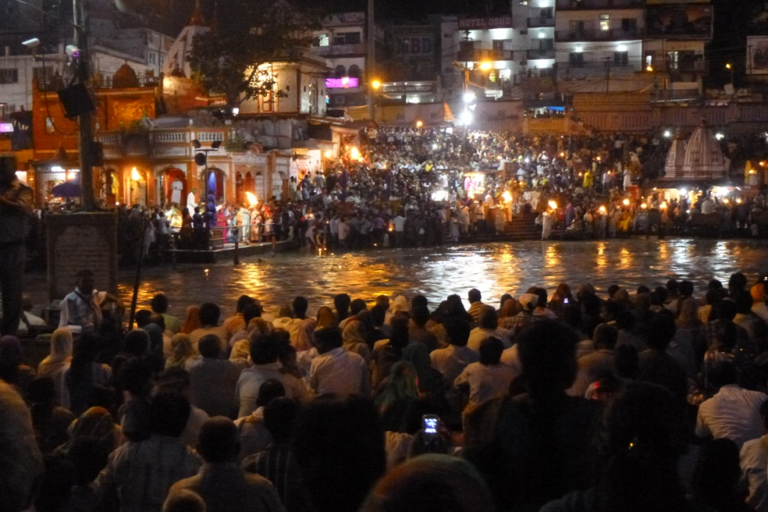
Conclusions
Healthy rivers are important to Indian people
Essential to human health and quality of life
Support economic activity
Healthy rivers need environmental flows
Decide what sort of river you want
Deliver the flow required

Slide 34
THANK YOU

